Slide 1
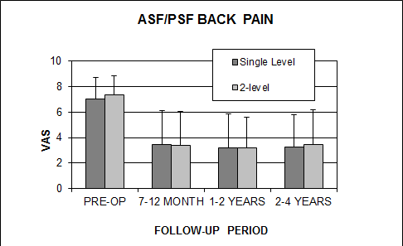
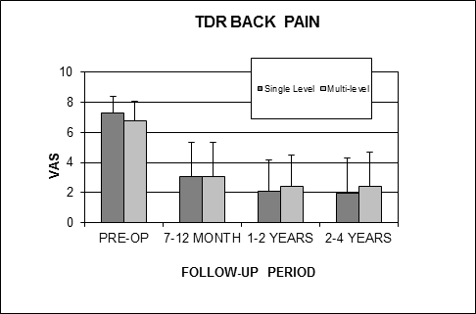
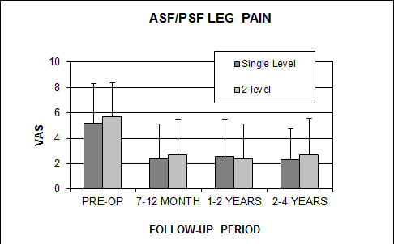
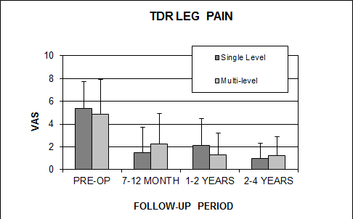
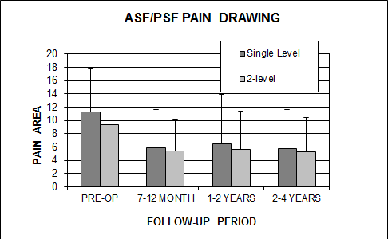
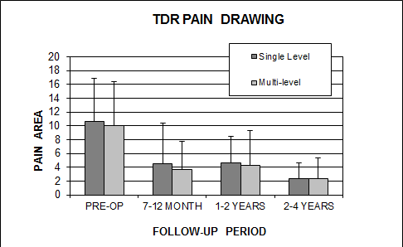
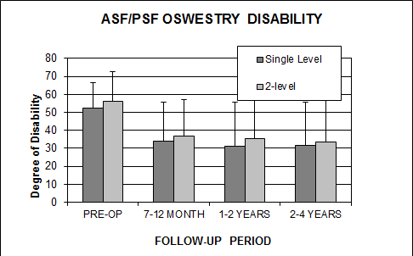
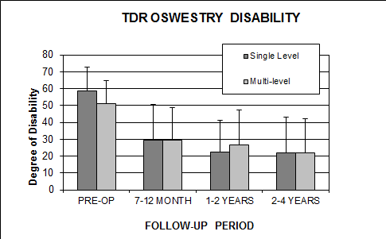
Lumbar Spinal Disc Replacement in a Community Practice Setting
Glenn Buttermann, MD
Midwest Spine & Brain Institute
Introduction
Comparative studies for a lumbar TDR in a community setting outside of an IDE setting are few.
Lumbar | Single Level TDR (n=26) | Single Level ASF/PSF (n=62)
Age (mean ± SD) | 36.0 ± 9.0 | 40.1 ± 11.4
Female (%) | 58 | 77
Smokers (%) | 53 | 42
Work Comp/Lit (%) | 37 | 31
EBL (ml, mean ± SD) | 89 ± 68 | 261 ± 214
Secondary Surgery (%) | 4 | 53*
Return to work (median, months) | 2.1 | 4.7
Purpose
Compare a lumbar TDR for one level conditions to fusion in a community spine practice.
Compare off label combination of disc replacement and spinal fusion as a “hybrid” construct for multilevel conditions.
Lumbar | Hybrid TDR (n=21) | Two-Level ASF/PSF (n=50)
Age (mean ± SD) | 44.8 ± 11.6 | 45.0 ± 11.6
Female (%) | 25 | 68
Smokers (%) | 42 | 50
Work Comp/Lit (%) | 67 | 48
EBL (ml, mean ± SD) | 246 ± 301 | 499 ± 296
Secondary Surgery (%) | 6 | 78*
Return to work (median, months) | 4.2 | 5.8
Methods
TDR (n=26) and single-level fusion (n=62) cohorts.
TDR hybrids (n= 21) and 2-level A/P fusion (n=50) cohorts.
Prospective outcomes, 2-4 year follow-up.
Hospitalization (LOS, EBL, implant costs).
Revisions, secondary operations.
Results
Both TDR and spinal fusion groups had significantly improved outcomes at all follow-up periods for both single and multilevel cases.
There was no significant difference in outcomes between single level and multilevel cases within both the fusion and TDR groups.
Single level cases, the TDR group had significantly greater ODI improvement relative to the fusion group at all follow-up periods.
Single level TDR had trend for greater VAS improvement at 1-2 yr and 2-4 yr follow-up periods.
For multi-level cases, the improvement of hybrid was not significantly greater than for fusion at all follow-up periods.
Implant costs were less for single level total disc replacement compared to spinal fusion but equivalent or greater for hybrid constructs compared to multilevel fusion constructs.
Range of motion was maintained in the total disc replacement groups.
Secondary surgeries were greater for the fusion groups (instrumentation removal and adjacent segment conditions).
*Most were instrumentation removal
Outcomes:
Discussion
Outcomes of current 1-level study similar to IDE studies and favor TDR.
Current TDR (& hybrid reconstructions) outcomes equivalent to or trend for better than fusion for properly selected patients.
TDR: Lower short-term reoperation rates and shorter return to work.
*
*
*
ISASS 2014 Annual Meeting ~ April 30th - May 2nd Miami, FL

