Slide 1
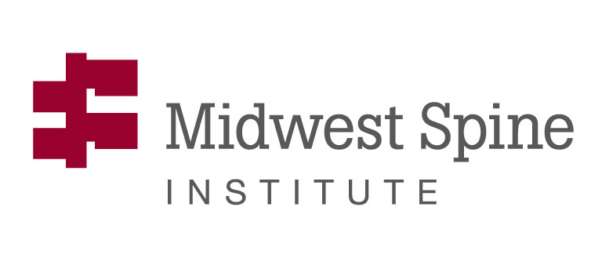
Glenn R. Buttermann, MD
XLIF vs ALIF Combined with PSF Results in a
Community Practice

Slide 2
Introduction
XLIF combined with posterior spinal fusion has increased in popularity for patients with advanced degenerative spinal conditions as well as selective deformity conditions.
Prior studies have predominantly been from academic institutions or by authors who had a financial relationship to a manufacturer with the potential for bias in reported outcomes.
The purpose of this study was to assess outcomes of an XLIF cohort and compare to a previous prospective cohort of traditional 2-level anterior/posterior spinal fusion patients treated for advanced degenerative disc disease.

Slide 3
Present Study
Indications for XLIF patient (n=41) were primary surgical fusion for lumbar DDD, adjacent segment degenerative condition, or as part of a hybrid procedure for spinal deformity.
Prospective study: Visual Analog Scale for back pain and leg pain, pain drawing, ODI.
Follow-up periods were at six-month to one year intervals with minimum two-year follow-up.
Comparative anterior/posterior spinal fusion cohort (n=50) had similar prospective outcomes evaluation.

Slide 4
XLIF/PSF vs ASF/PSF

Slide 5
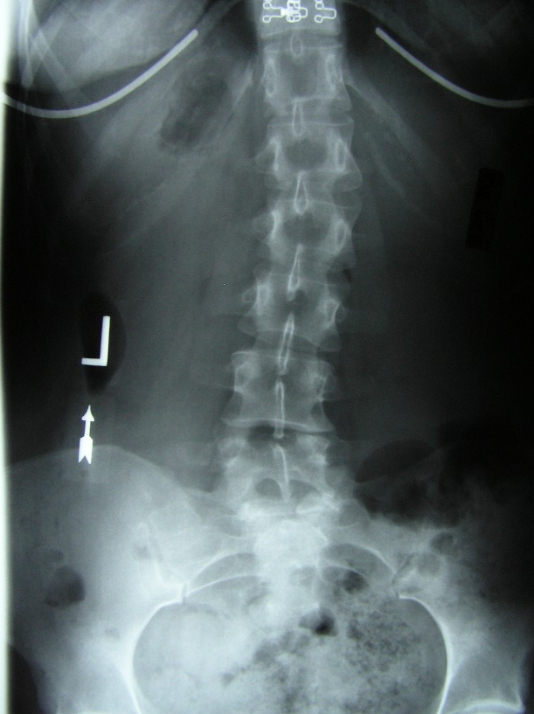
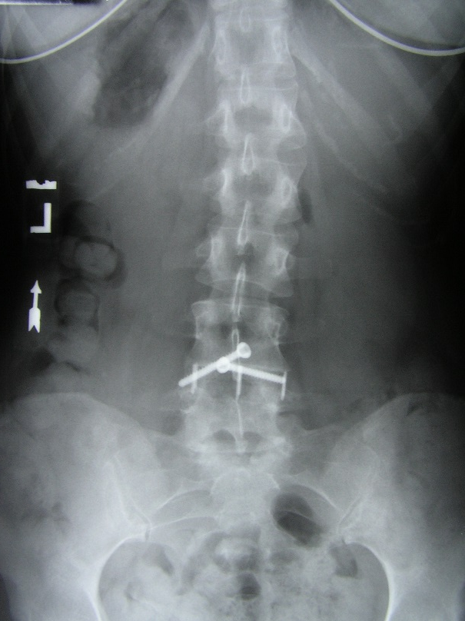
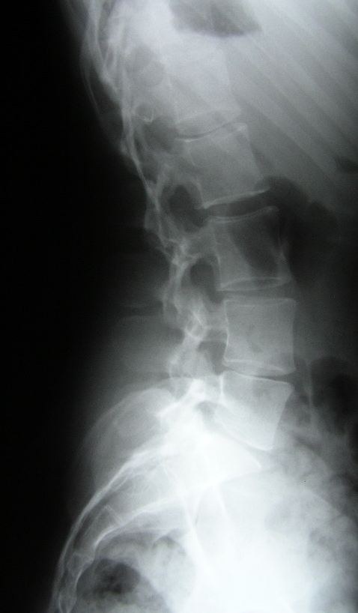
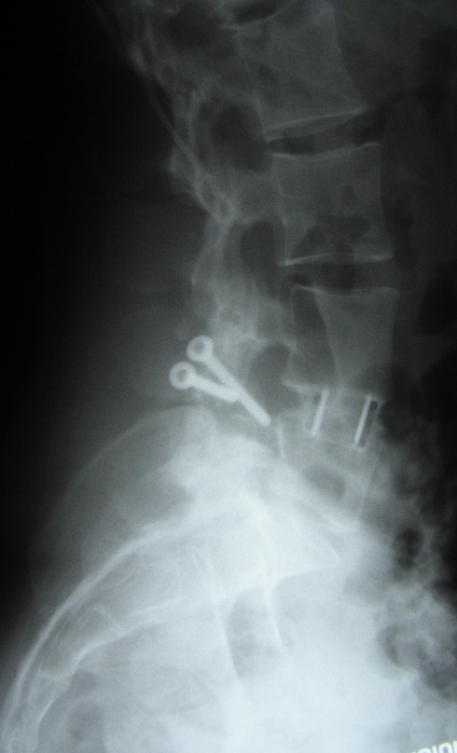
Major XLIF Dx
Primary Degenerative condition
  Example: L45 post-lami DDD
  Preop Postop

Slide 6
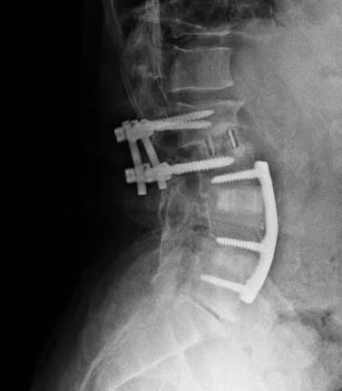
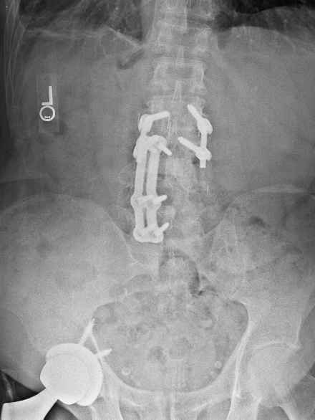
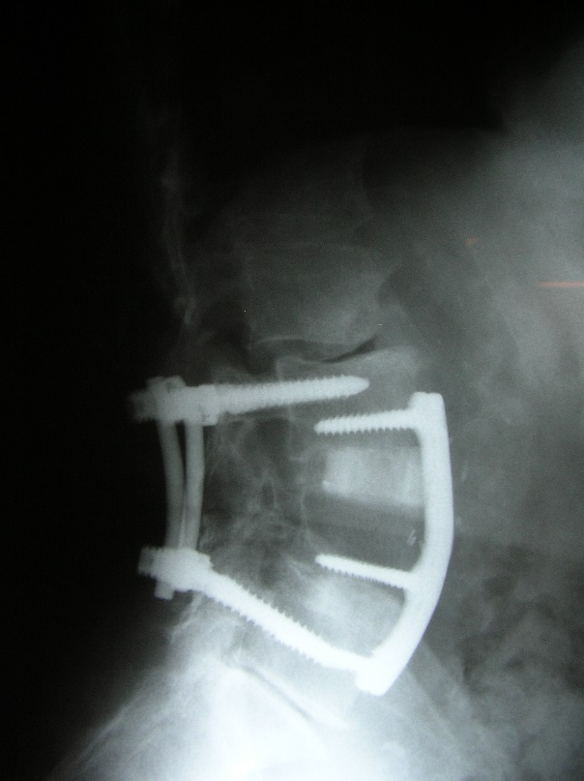
Major XLIF Dx
Adjacent segment degenerative condition
  Example: L23 Adj DDD/stenosis/retrolisthesis
    Preop Postop

Slide 7
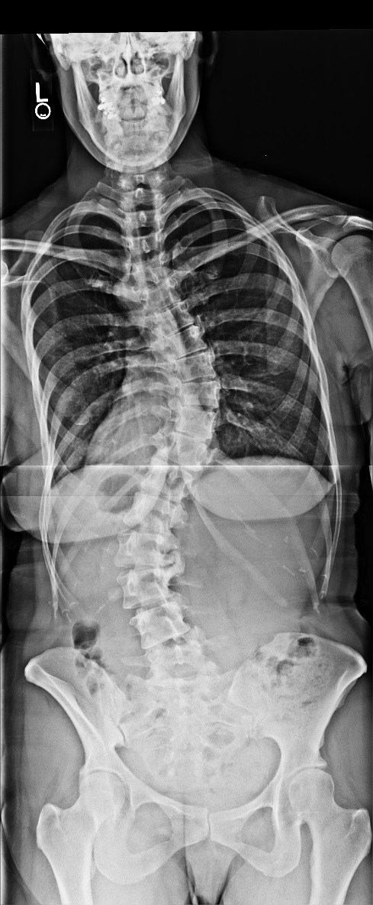
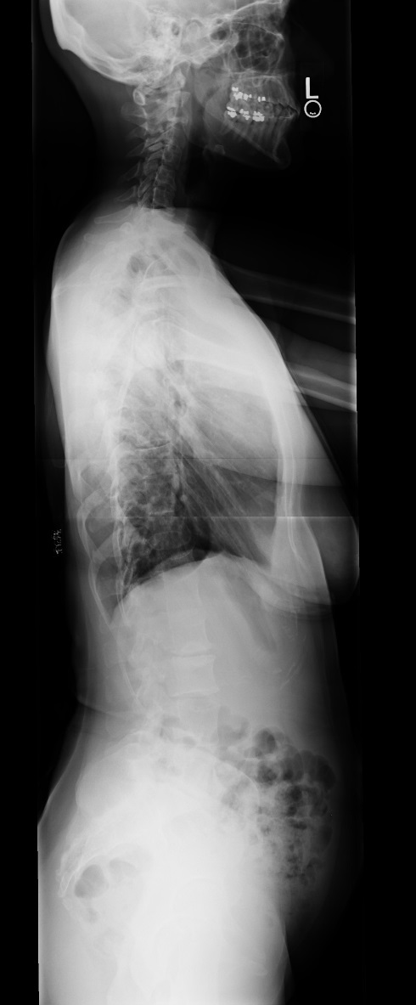
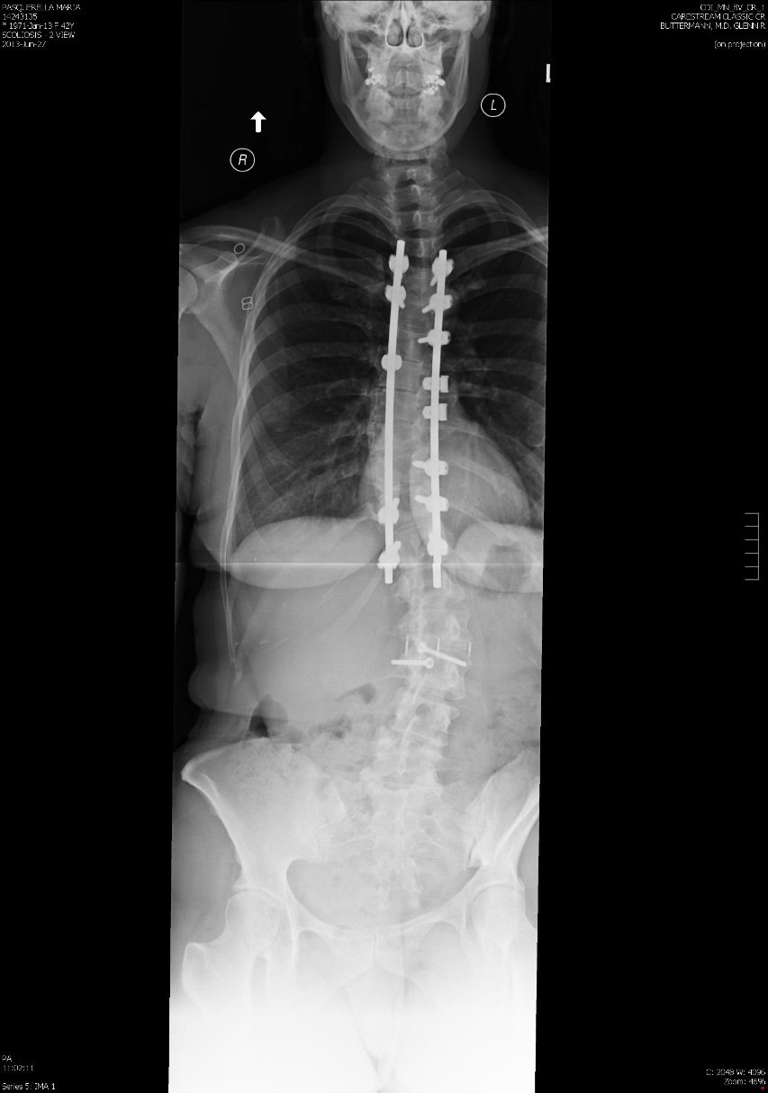
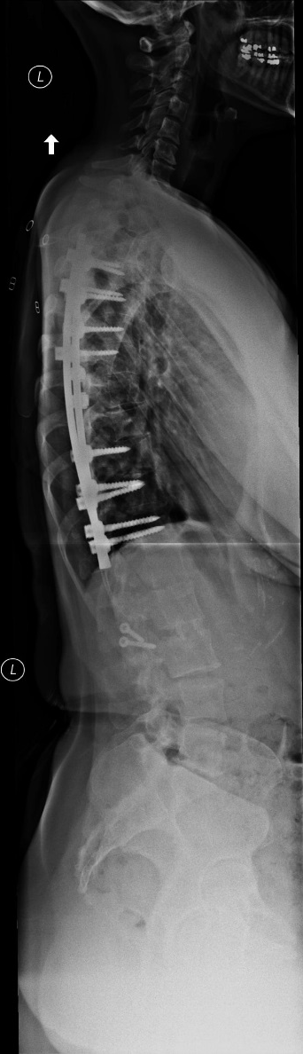
Major XLIF Dx: Adult Deformity
Example: AIS lumbar motion segment sparing method

Slide 8
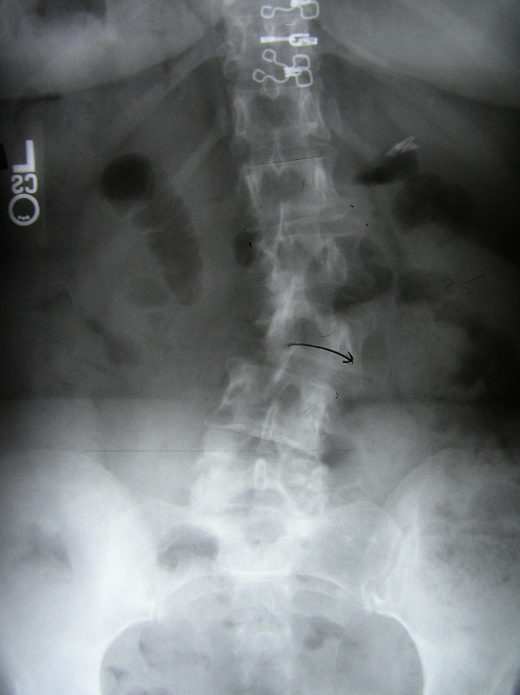
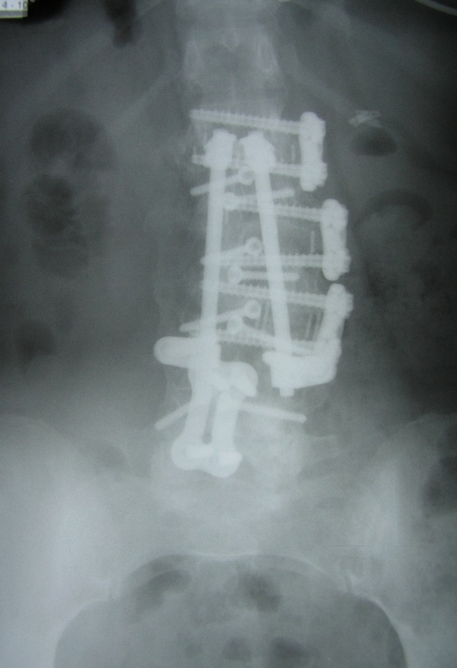
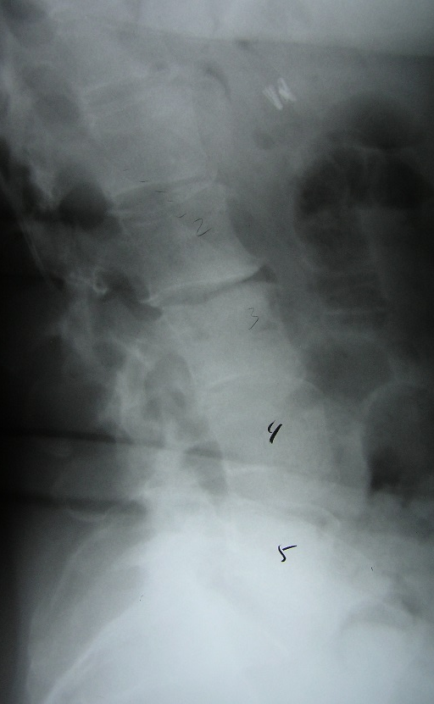
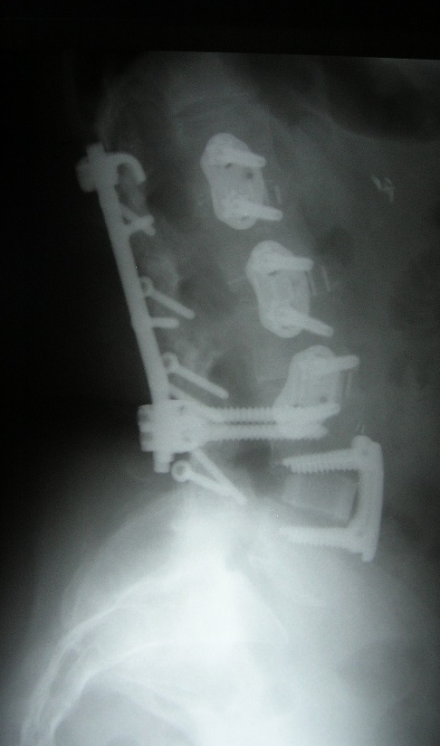
Major XLIF Dx: Adult Deformity
Degenerative scoliosis, spondylolisthesis & stenosis

Slide 9
Low Back & Leg Pain Outcomes

Slide 10
Pain Drawing & ODI Outcomes

Slide 11
Results
Most common indication for XLIF was adjacent level degenerative condition s/p prior lumbar fusion (29 of 41 patients).
Both XLIF/PSF and ASF/PSF groups had significantly improved outcomes at all follow-up periods.
There was no significant difference in outcomes between XLIF/PSF and ASF/PSF groups, however demographics differ between cohorts.
Patients in both XLIF and AP fusion groups who had interbody device subsidence were found to have osteoporosis.
Transient neurological deficits were most common at L4-5 in the XLIF cohort.

Slide 12
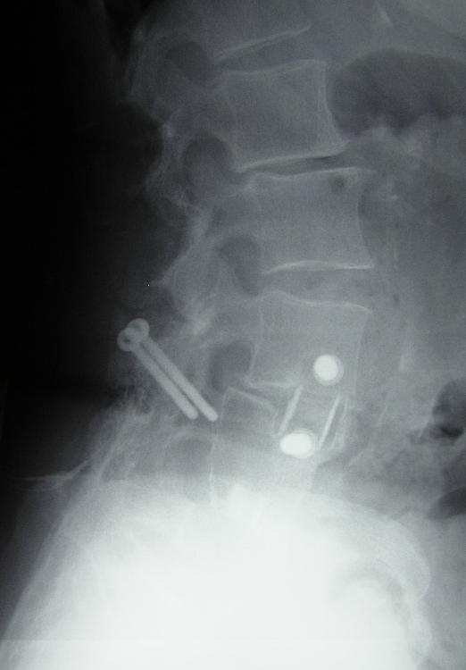
Discussion
The outcomes of XLIF combined with PSF were statistically similar to ASF/PSF outcomes in patients undergoing primary fusion.
The XLIF approach avoids potential complications related to revision ASF approach in patients who have adjacent level conditions yet obtains similar clinical success.
Patients with osteoporosis require additional individualized treatment:
Subsidence in osteoporotic pt.

